Slide 1

Exploring the evolution of book borrowing patterns and user engagement in Netherlands Libraries
Susy Costa
2023

Slide 2

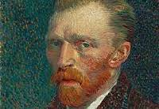
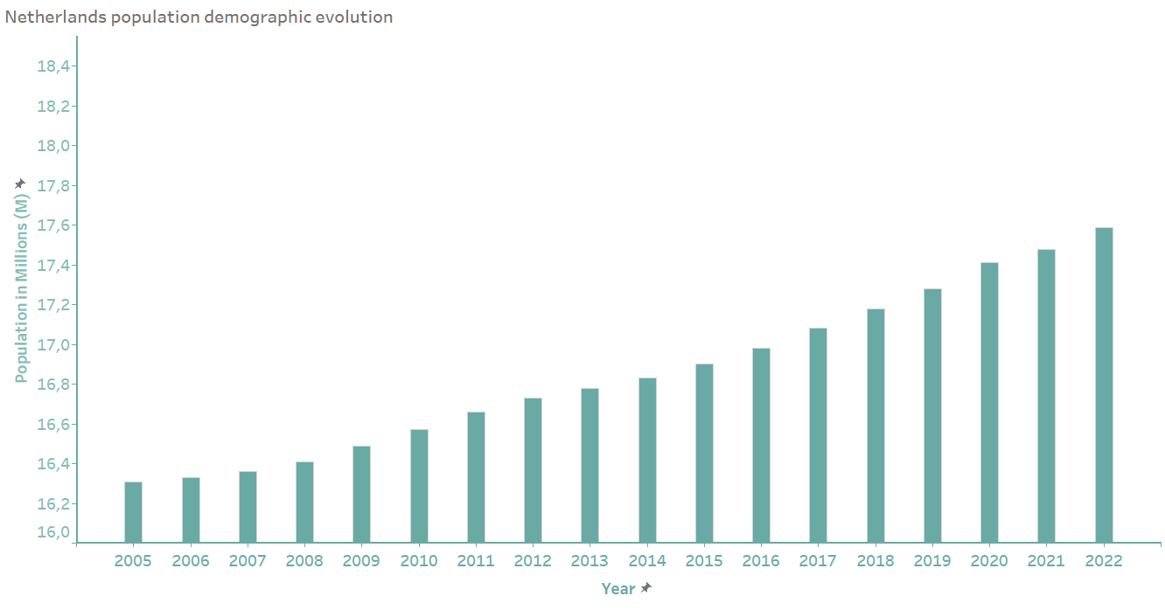
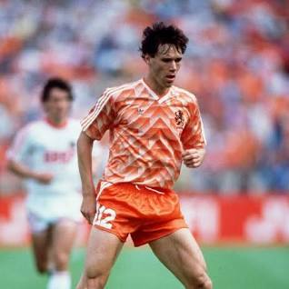

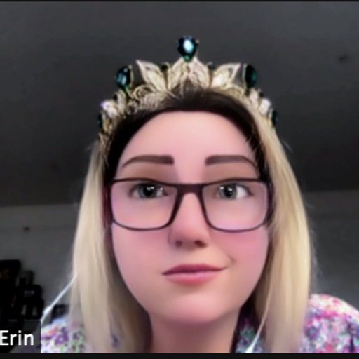
Welcome to…
Over 17 Million

Slide 3
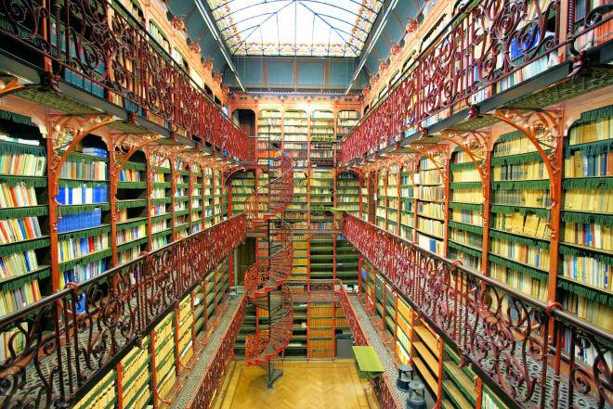
What’s the Goal?
In this presentation, we'll explore how book borrowing habits and user engagement have changed in Netherlands libraries over the last 18 years (2005-2022)
Our aim is to uncover the changes in library dynamics, offering a comprehensive understanding of how user behavior and borrowing preferences have transformed within the Netherlands libraries.
Handelingenkamer | Old library

Slide 4

Methodology
Data Collection
Data Cleaning and Preparation
Exploratory Data Analysis (EDA)

Slide 5
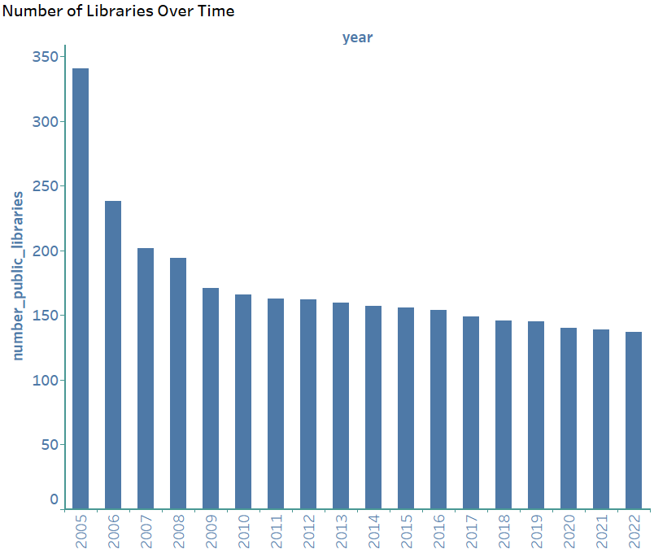

Library distribution
Maximum libraries in 2005 (341)
Minimum libraries in 2022 (137)
Average of 173 available libraries per year

Slide 6

WHOA!
LET’S SAY
Cannot stop thinking about how great was that drop in the number of libraries in the country.
Look on the bright side: there are still some libraries to go!

Slide 7
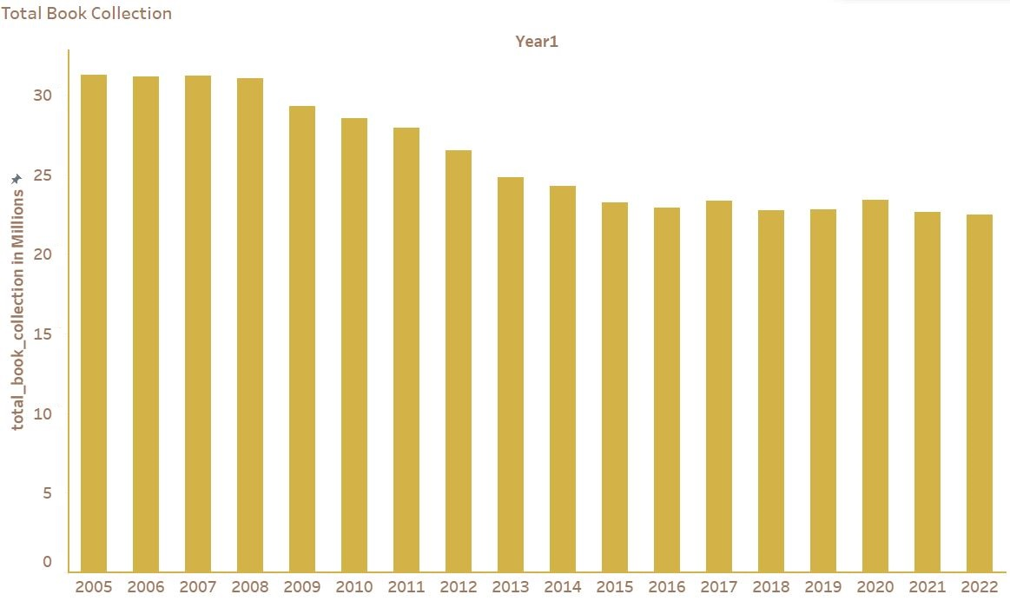
Library distribution - book collection
Maximum collection values in 2005 (35,440,000 items)
Minimum collection values in 2022 (23,542,000 items)
Average total collection of 28,361,000 items per year

Slide 8
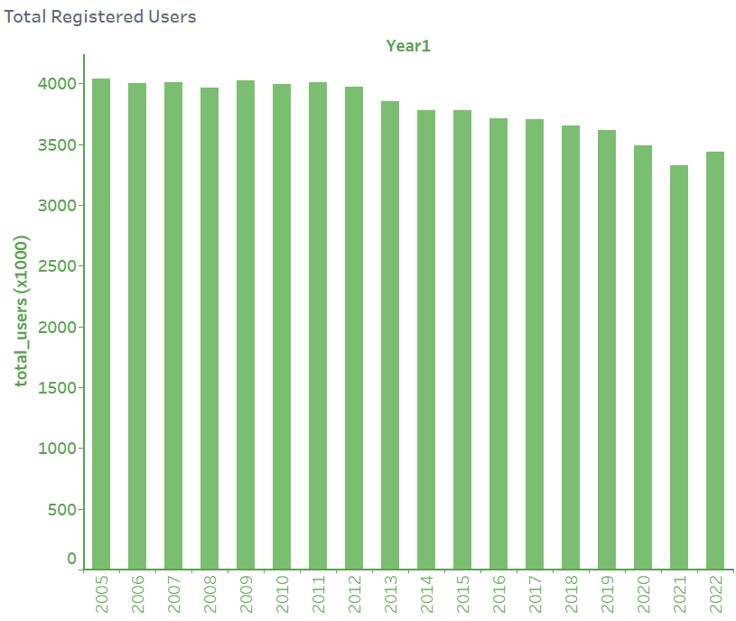
Library distribution – users
Maximum users regsitered in 2005 (4,039,000)
Minimum users regsitered in 2021 (3,330,000)
Average users per library of 3,800,000

Slide 9
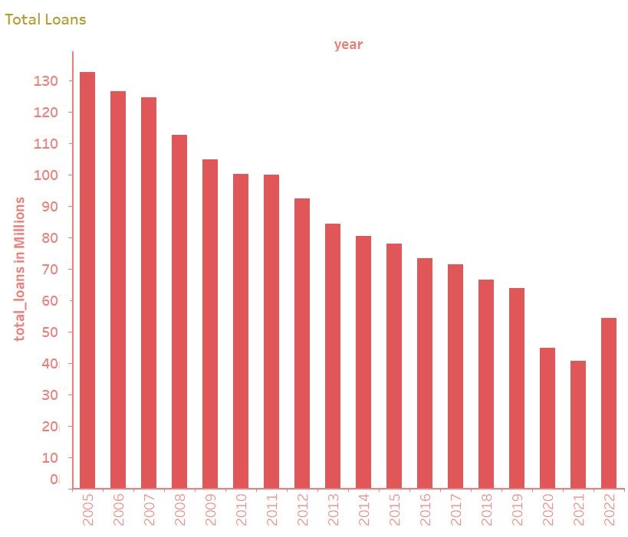
Library distribution – loans
Maximum loans regsitered in 2005 (132,579,000)
Minimum loans regsitered in 2021 (40,778,000 )
Average loans per library of 86,227,22

Slide 10
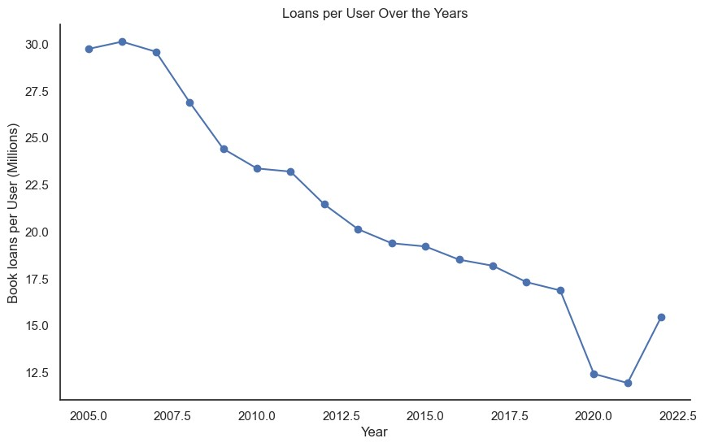
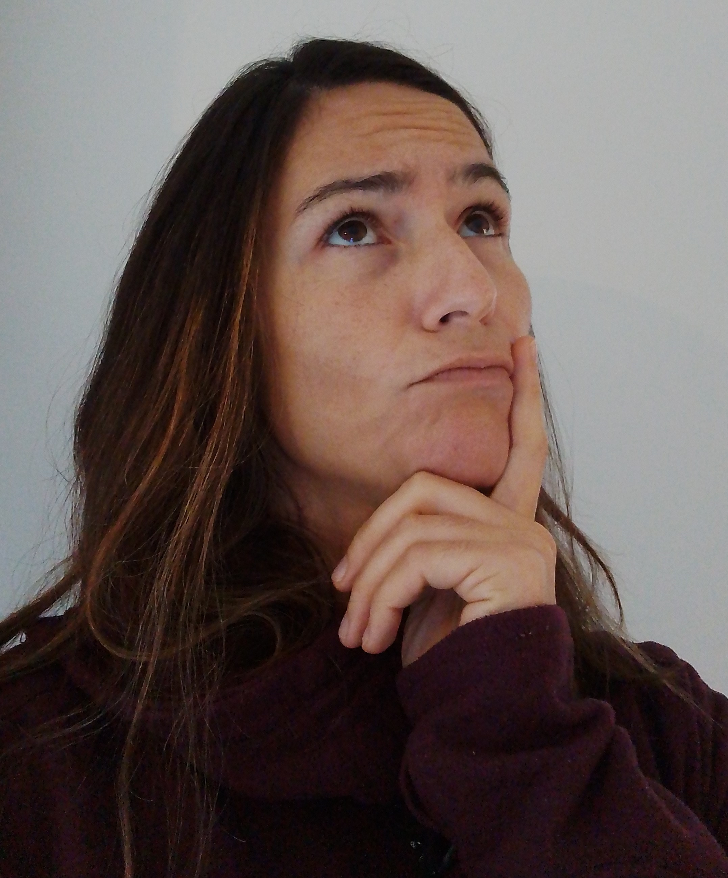
User Engagement Analysis
Maximum book loans/user in 2005 (30 books)
Minimum book loans/ user in 2021 (13 books)
Average book loan per user of 21 books/year

Slide 11

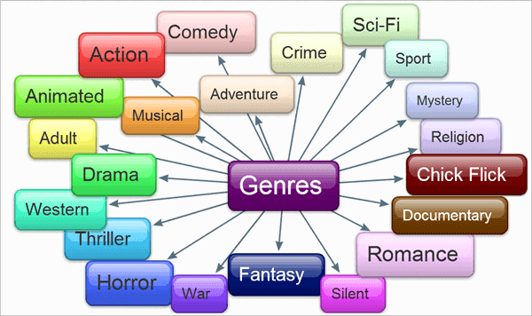
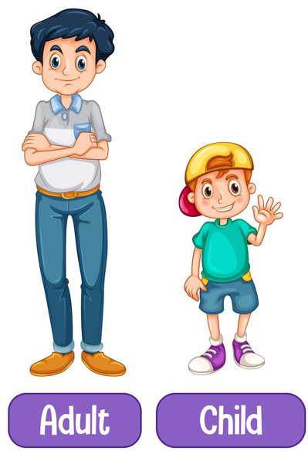
Book Borrowing Pattern Analysis
Category
Other
User Age
ANY CORRELATION?

Slide 12
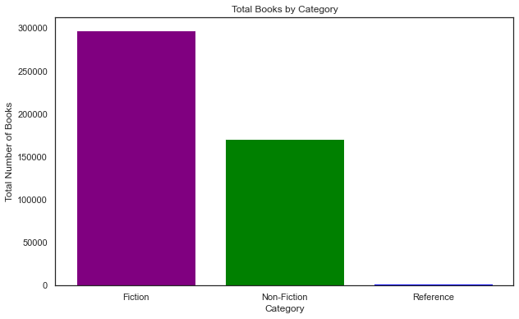
Book Borrowing Pattern Analysis - Category

Slide 13
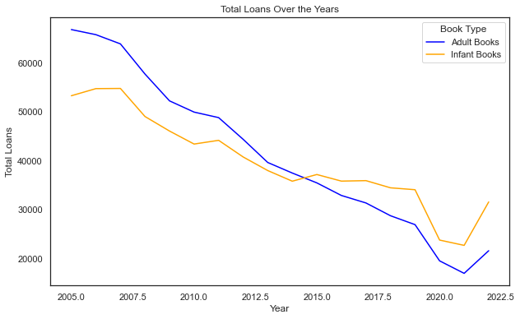
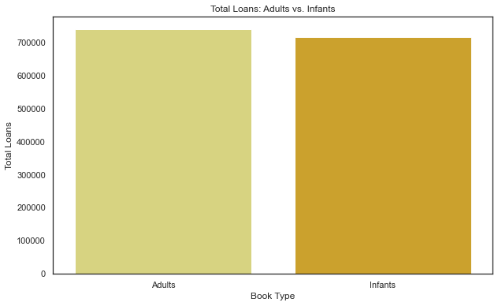
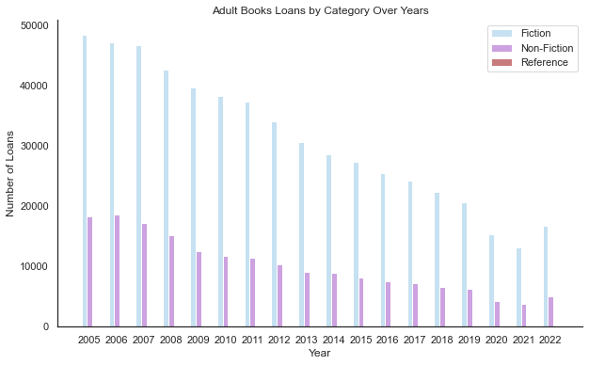
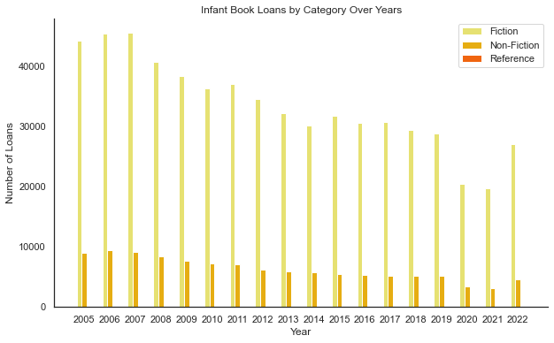
Book Borrowing Pattern Analysis – User Age
SIMILAR CHOICES

Slide 14

Book Borrowing Pattern Analysis – Correlations
Keep in mind that correlation does not imply causation; it simply measures the strength and direction of a linear relationship between variables.

Slide 15
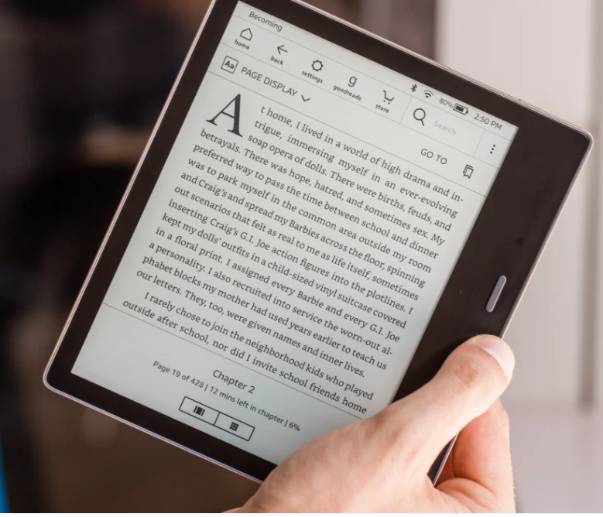
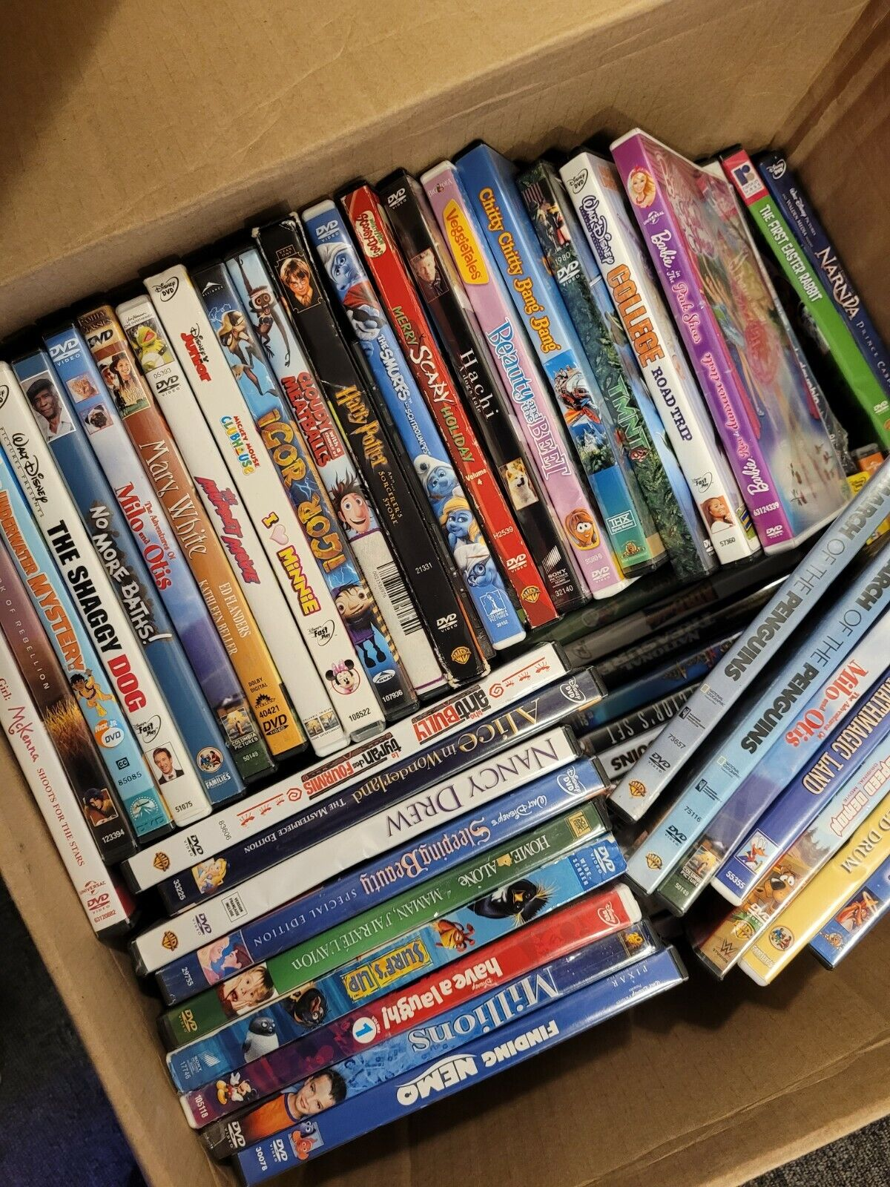

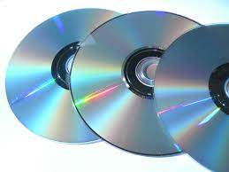

Borrowing Patterns Analysis - Other
Pandemic Diseases
New technologies

Slide 16

Libraries
Book Collection
Book Loans
Book Options
Users

Slide 17
There are some ways to try change this tendency:
Diversify book collections
Personalized recommendation services
Cultural and literary events

Slide 18
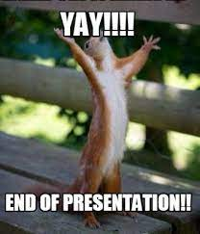
THANK YOU /
HARTELIJK DANK /
MUITO OBRIGADA

